Slide 1


Slide 2
INTRO TO
DEEP LEARNING

Slide 3
WHAT IS DEEP LEARNING ?
Deep Learning is an evolved form of Machine Learning which tries to simulate the human brain in its very limited capacity.
So far in previous session, we’ve seen very simple algorithm architecture:
Two Layer Architecture:
x -> y
(Mapping input to output)

Slide 4
Contd .
The Human Brain Doesn't Work in This Two Layer Architecture :
The human brain works in many levels of Processing. At each level of processing, it acquires increasing levels of abstraction.
This inspired the formation of Deep Learning.

Slide 5
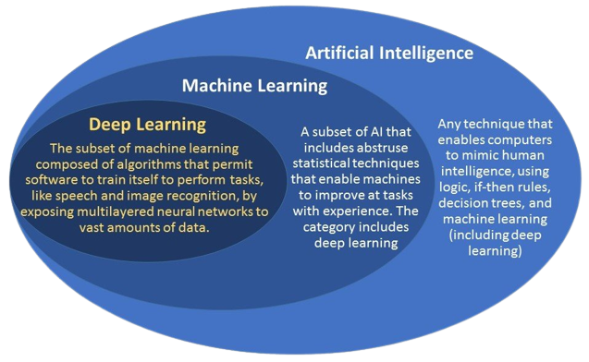

Slide 6
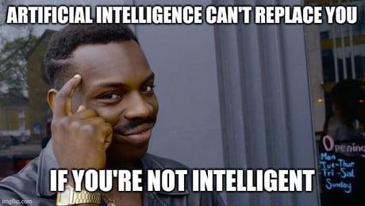
Let's Get Started!
Notes:
No

Slide 7
TABLE OF CONTENTS
01
03
05
07
NEURONS
OVERFITTING AND UNDERFITTING
BINARY CLASSIFICATION
ACTIVATION FUNCTION
02
04
06
LAYERS
STOCHASTIC GRADIENT DESCENT
DROPOUT
AND BATCH NORMALIZATION

Slide 8
NEURONS
01

Slide 9
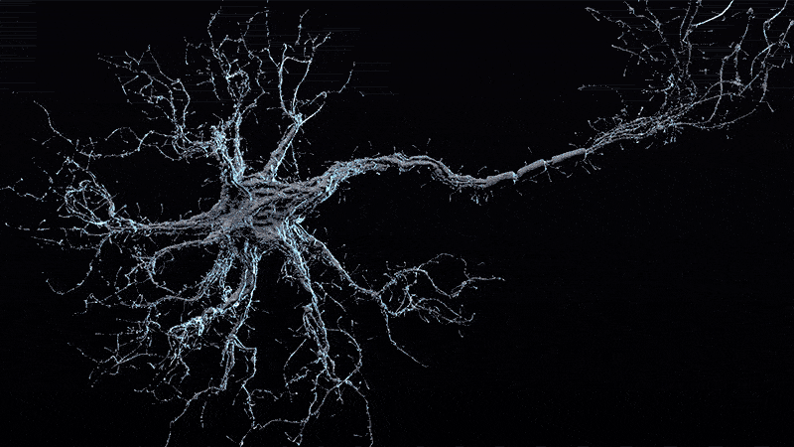
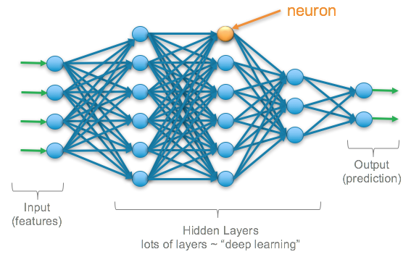
Neurons :
Not these!
These!

Slide 10
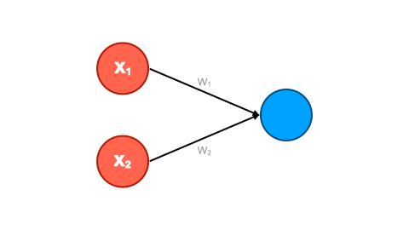
WHAT ARE NEURONS ?
Neurons in deep learning models are nodes through which data and computations flow.
A single neuron performs a single (simple) computation.
Whenever an input flows through the neuron, it scales it by a weight and adds a bias that adjusts output value.
Learning in a Neuron :
Adjusting the weights and bias
Single Neuron with two Input and one output

Slide 11
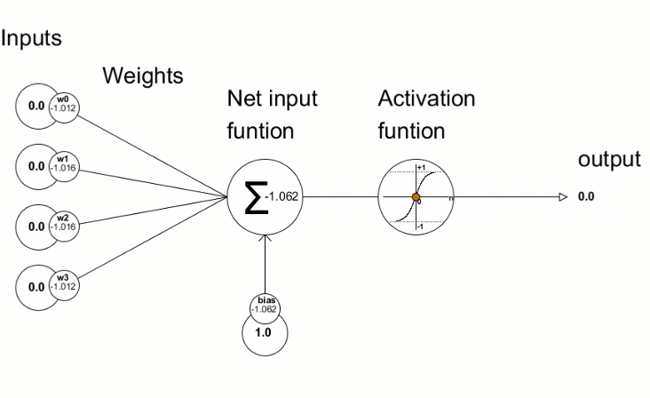
Neurons with Multiple Inputs and
Single Output :
Linear Equation :
y = w1*x1 + w2*x2 + ..... + wn*xn + b
Bias(b) is added implicitly here.

Slide 12
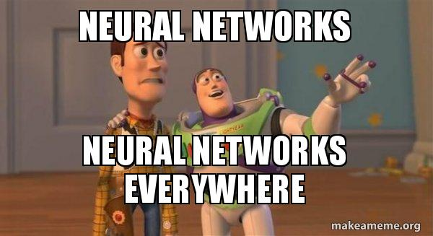
Now Let's Make our own Neuron!
Notes:
No

Slide 13
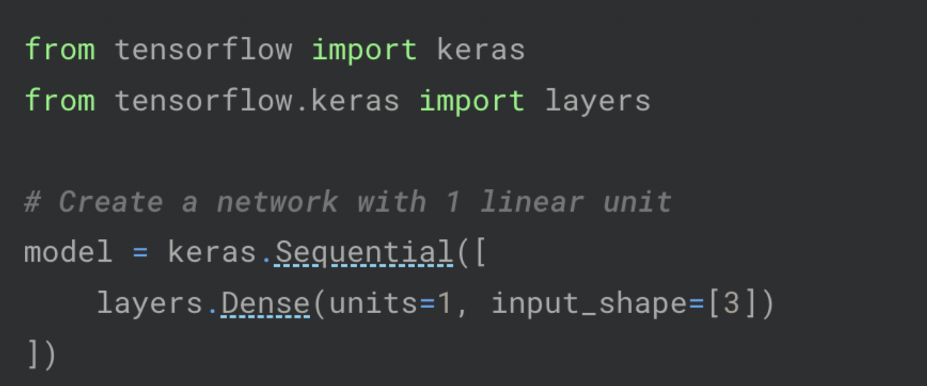
REQUIRED CODE :
Creating a neuron
Importing libraries

Slide 14
LAYERS
02

Slide 15
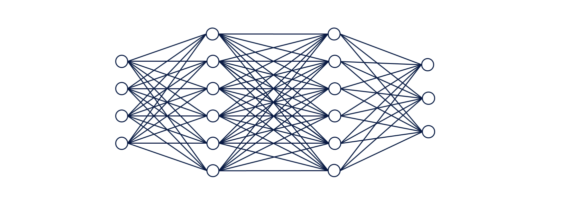
WHAT ARE LAYERS ?
Adding layers helps you build more complex neural networks from linear units .
Think of layers like data transformation.
Dense Layer: Neurons in the layer receive input from each neuron of the previous layer

Slide 16
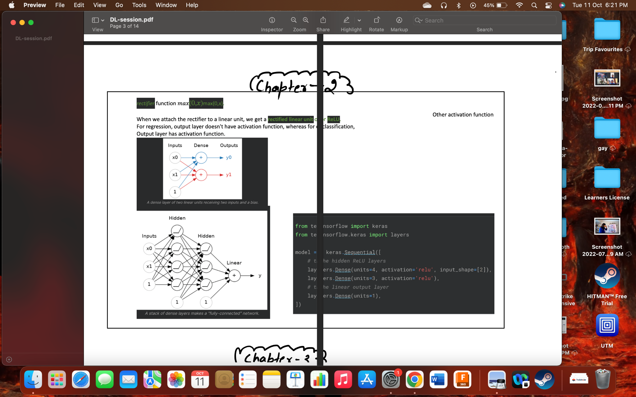
Examples :
A dense Layer of two linear units receiving two inputs and a bias .
A stack of dense layers makes a fully connected network .

Slide 17
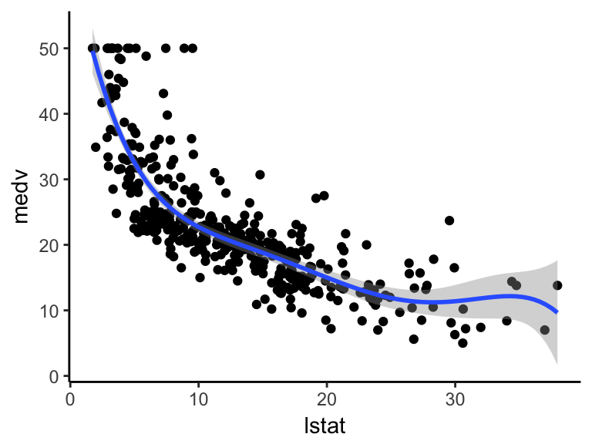
Problem :
Simply making Dense layers always maps a linear relationship .
But How to Model Nonlinear Functions?

Slide 18
ACTIVATION FUNCTIONS
03

Slide 19
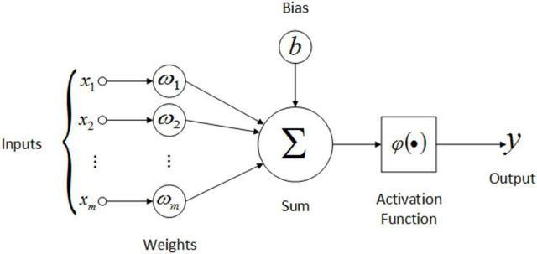
Solution: Activation Functions
An Activation Function decides whether a neuron should be activated or not. This means that it will decide whether the neuron's input to the network is important or not in the process of prediction using simpler mathematical operations.

Slide 20
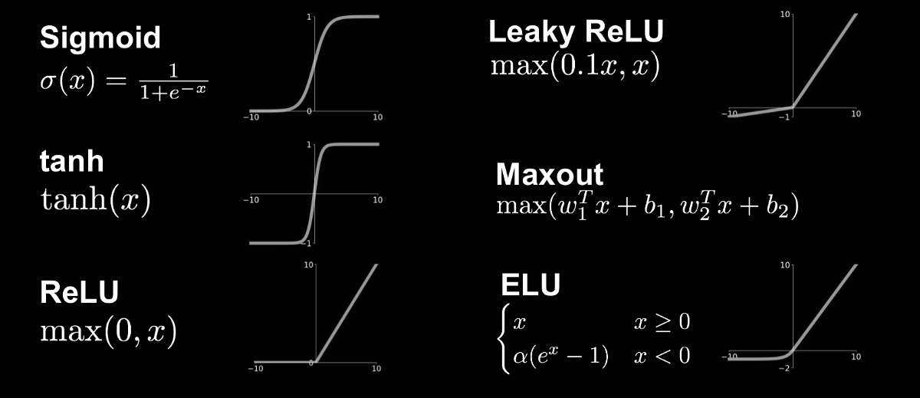
Types of activation functions:

Slide 21

ReLu Function :
Here we’ll focus mainly on the Relu function.
Relu function activates the neuron only when the output is greater than zero.

Slide 22
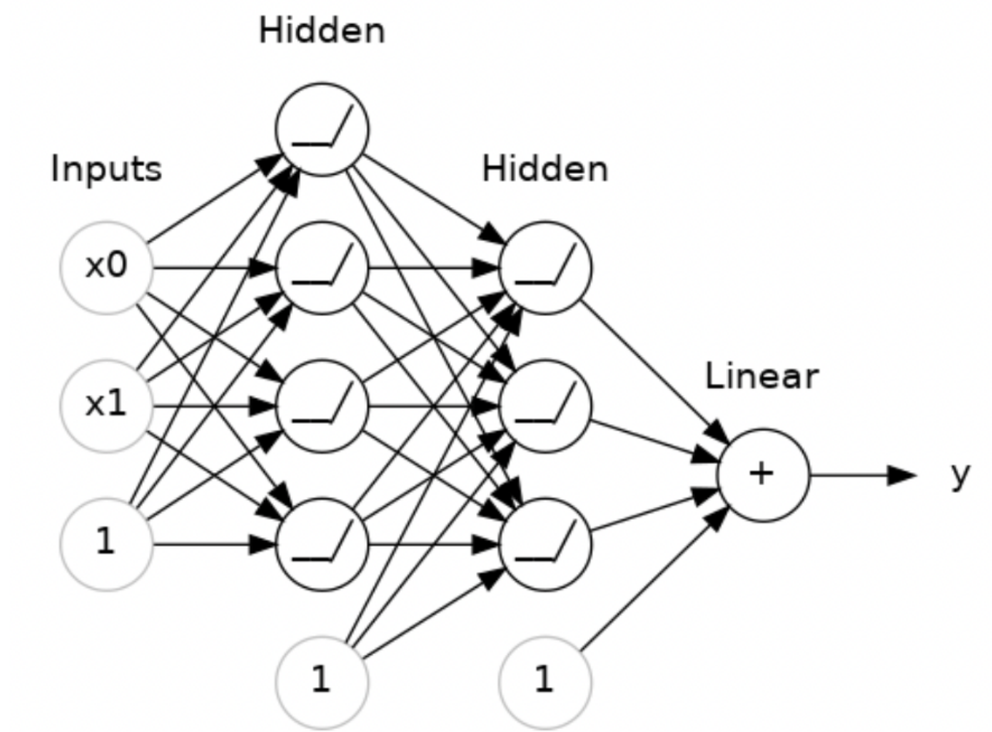
Dense Layers with the ReLu Function
Activation function for the output neuron here is set to be linear (Good for regression task).
For Classification Like Problem, it could have been set to Sigmoid Activation Function.

Slide 23

Let’s make our neuron with relu function

Slide 24
Required code for this model :
1st Layer
model = keras.Sequential([
layers.Dense(units = 4, activation = ‘relu’, input_shape = [2]),
layers.Dense(units = 3, activation = ‘relu’),
layers.Dense(units = 1)
#not activating the output layer, it remains linear.
])
2nd layer
3rd layer

Slide 25
STOCHASTIC GRADIENT DESCENT
04

Slide 26
Training the Neural network :
LOSS FUNCTION
OPTIMIZER
To measure how good is the chosen set of parameters for any prediction .
Given a set of Parameters and its Losses, modifying the parameters to get a better set.
Having built a neural network, we now need to train it. Initially the weights of the neural networks are set randomly .
We need two things to begin training our neural network

Slide 27
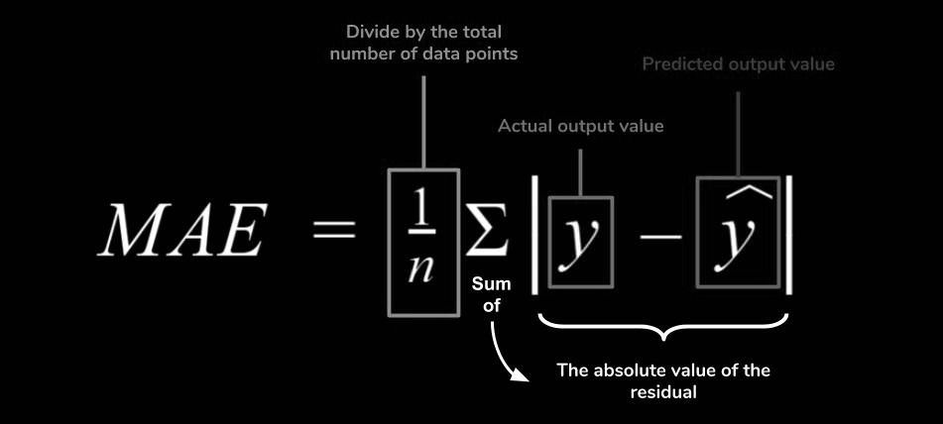
Loss Function :
Measures how far are the target's true values and the model's predicted values
Common Loss Function: Mean Absolute Error (MAE)
For each Prediction: MAE ( Mean Absolute Error ) is given as:

Slide 28
Optimizer :
Our Motive is to reduce the Loss function below a certain Threshold (or it converges) : The Optimizer
Class of Optimization Algorithms: Stochastic Gradient Descent
Excessively Simplified Algorithm:
Randomly Initialise the parameters and make predictions
Measure Loss
Adjust The Weights in the direction that minimises the loss

Slide 29

For this exercise, we would use an Optimizer called Adam which is a part of the Gradient Descent Family to optimise our Parameters :
model.compile(optimizer = ‘adam’ , loss = ‘mae’)
Let's Code!

Slide 30
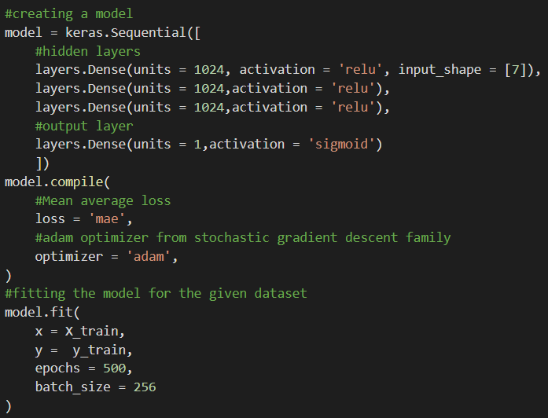
Combining all we’ve learned :
Epochs: The number of iterations for which the Optimization algorithm runs
Batch_size : No. of samples in training dataset that is used for training in one iteration of the optimization algorithm

Slide 31
05
OVERFITTING AND UNDERFITTING

Slide 32

Overfitting and Underfitting :
Noise are random fluctuations in the actual values of the data.
In every real world dataset, we face a problem:
As we try to minimize the cost function it also decreases with the noise in the training dataset. (As the cost function is modeled after the training dataset.)
To keep this problem in check, we need to simultaneously compute our cost for validation data.
NOISE

Slide 33
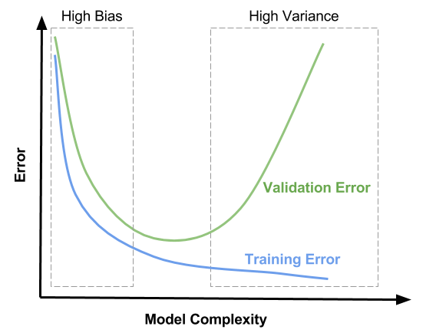
Overfitting and Underfitting :
Initially as seen in the graph both the error decreases as here the model learns the signal but when the validation error starts increasing it represents that the model has started to learn the noise. Thus we need to stop before this point.
Bias = difference between predicted and actual value.
Variance = variability of model prediction for a given data point

Slide 34
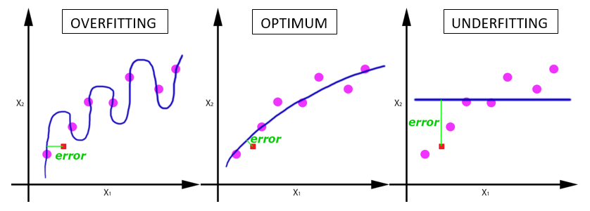
Overfitting and Underfitting :
Initially the model is said to be underfitted. (too generalized)
When the model starts to learn the noise, it is said to be overfitted.
(too specific to training data)

Slide 35
Method to prevent Underfitting :
Increase the model capacity.
Ways to increase the model capacity :
Make the neural network deeper. (increase no of layers in the model)
Make the neural network wider. (increase no of neurons in a layer)
Model Capacity :
Complexity of patterns that the model can learn.

Slide 36
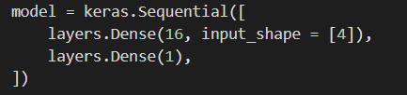
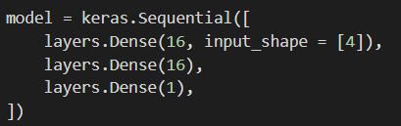
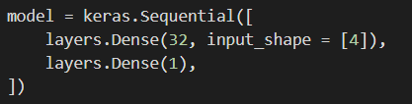
Code to make Model :
a.) Deeper
b.) Wider

Slide 37
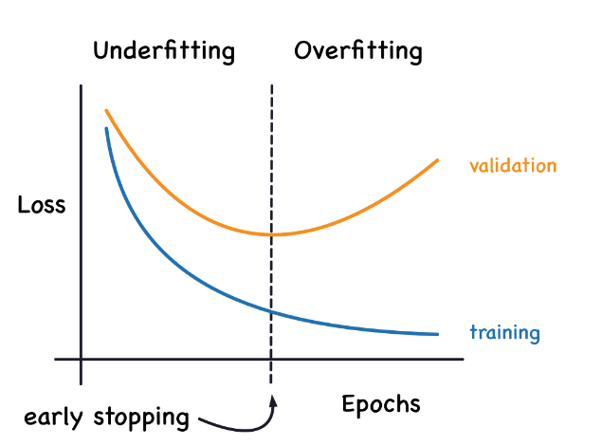
Method to prevent Overfitting :
To prevent overfitting we can use a method known as Early stopping.
Early stopping :
It is feature that stops optimizing the model before it starts to learn the noise.

Slide 38
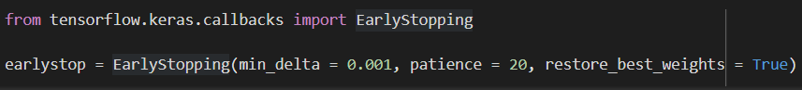
Early Stopping :
To add early Stopping in the model :
While fitting we set parameter callbacks = [earlystop]
Command line:
Min_delta :
refers to how much change is counted as improvement
Patience :
After how many epochs to stop, if there is no improvement
Restore_best_weights : refers to whether after we’ve stopped, best model weights should be restored

Slide 39
06
DROPOUT AND BATCH NORMALIZATION

Slide 40
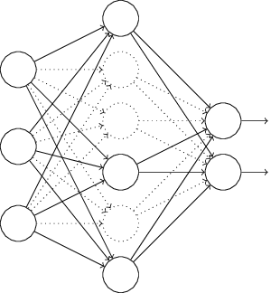
Dropout (Regularization) :
Dropout layer
It is a regularization technique where some randomly selected neurons are ignored during training.
Dropout layer:
Solves the issue of overfitting by randomly dropping some layer inputs in every iteration.
Since some of the layers are being dropped out, the model will never try to specifically model for the training data thereby generalizing the results, giving a broader set of parameters that don’t overfit.

Slide 41
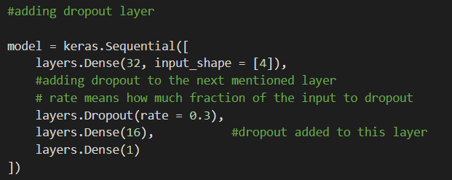
Code to Add Dropout layer :

Slide 42
Batch Normalization
It is an algorithm method to make the training of Deep Neural Networks(DNN) faster and more stable .
Batch Normalization :
Helps train model faster .
Makes Scholastic Gradient descent more stable .
We can normalize the data inside the network by implementing layer called batch normalization layer .
Normalization is done using the mean and standard deviation of the batch .

Slide 43
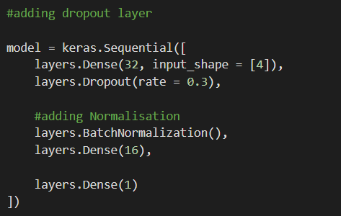
Code to implement Batch Normalization
We have to code after the layer for which we want to apply the normalization .

Slide 44
Metrics : Measuring how good our model is!
Metrics are functions that are used to judge the performance of our model (during training and testing) .
Some Metrics :
Accuracy :
Number of correct predictions/total number of predictions
Cross entropy :
It is the measure of difference between two probability distributions.

Slide 45
Cross Entropy :
We find the cross entropy between the predicted values and the real values.
If the value of cross entropy is high then we can say that the model is not good and
if the value of cross entropy is low (near to zero) then we can say that the model is good.

Slide 46
BINARY CLASSIFICATION
07

Slide 47
Binary Classification :
It is the task classifying elements of a set into two groups.
For binary classification, we need to map the real valued outputs of our neural network to two bits {0,1}.
After getting values between 0 and 1 we can classify all the values with output greater than 0.5 as 1 and all the values less than 0.5 will be classified as 0.
We can use the Sigmoid function to map the real valued outputs of our neural network to values in range 0 to 1.

Slide 48

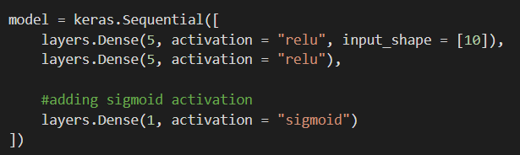
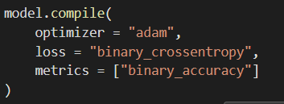
Sigmoid Function and Binary classification code :
Sigmoid Function:
Implementation :

Slide 49

Recap Quiz
Let’s test your Concentration

Slide 50
THANKS
CREDITS: The presentation was created by Ekansh Singh , Samvaidan Salgotra , Taraksh Sambhar , Udayveer Virk
Any Queries ?
Website : Heuristics - IIT Mandi

